Slide 1
Android
Instructor: Zonghua Gu

Slide 2
Overview

Slide 3
Android
A S/W stack for mobile devices developed and managed by OHA
A free S/W under Apache License
Android
Key Applications
Middleware
Operating System (Linux Kernel 2.6)
Notes:
2

Slide 4
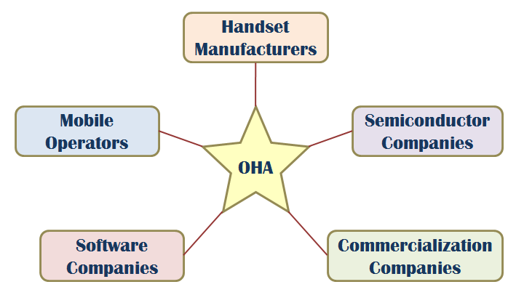
OHA (Open Handset Alliance)
A business alliance consisting of 47 companies to develop open standards for mobile devices

Slide 5
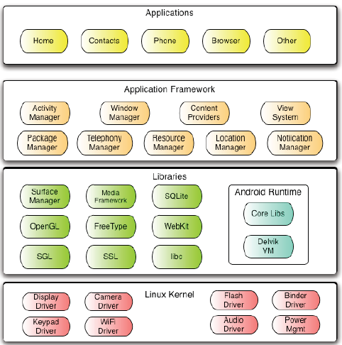
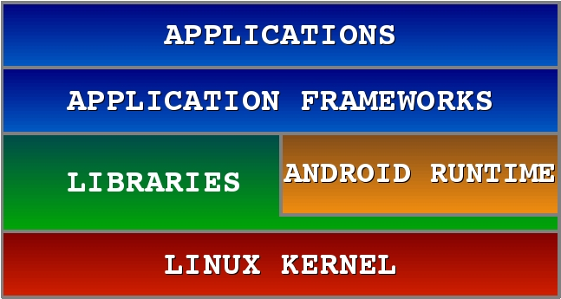
Android Software Stack

Slide 6
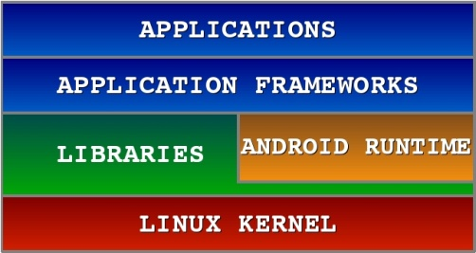
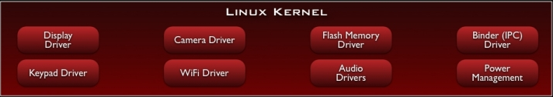
Android S/W Stack – Linux Kernel
Relying on Linux Kernel 2.6 for core system services
Memory and Process Management
Network Stack
Driver Model
Security
Providing an abstraction layer between the H/W and the rest of the S/W stack

Slide 7
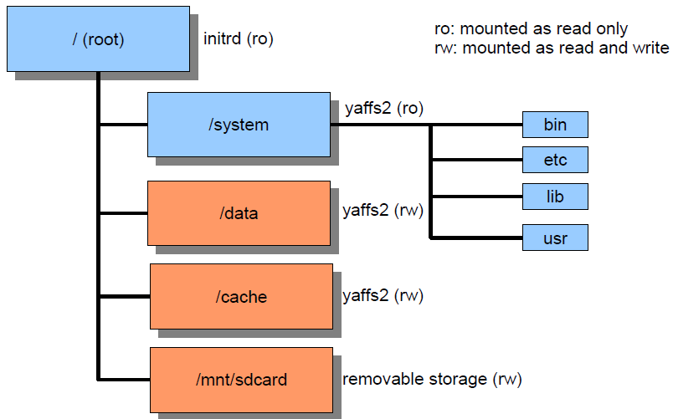
Directory Structure

Slide 8
Android S/W Stack – Linux Kernel (Cont)
Kernel Enhancements
Alarm
Kernel Debugger
Ashmem
Binder for IPC
Wakelock for Power Management
Low Memory Killer
Logger

Slide 9
Ashmem
Android / Anonymous SHared MEMory subsystem
$(TOP)/system/core/cutils/ashmem.h
int ashmem_create_region(const char *name, size_t size)→returns fd
int ashmem_set_prot_region(int fd, int prot)
int ashmem_pin_region(int fd, size_t offset, size_t len)
int ashmem_unpin_region(int fd, size_t offset, size_t len)
Kernel reclaims not ‘pin’ ed memory
Similar to weak reference of Java. Useful for implementing cache.
Accessed as android.os.MemoryFile from Java program

Slide 10
Binder
Binder
Driver to facilitate IPC between applications and services
Problems of Linux IPC
Applications and Services may run in separate processes but must communicate and share data
IPC can introduce significant processing overhead and security hole
Properties of Binder
High performance IPC through shared memory
Per-process thread pool for processing requests
Reference counting and mapping of object references across processes
Synchronous IPC calls between processes
A special device driver /dev/binder

Slide 11
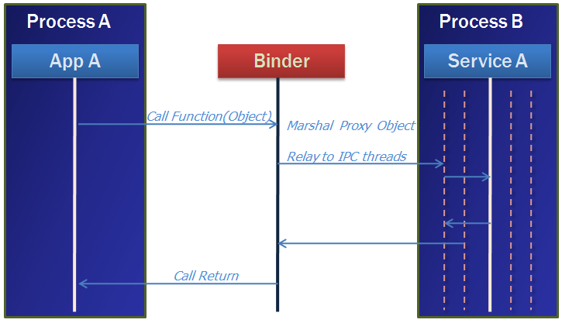
Binder (Cont)
A pool of threads is associated to each service application to process incoming IPC.
Binder performs mapping of object between two processes.
Binder uses an object reference as an address in a process’s memory space.

Slide 12
Low Memory Killer
Upon detecting memory shortage, the kernel can select a process with low priority and kills it.
It's OK. because specification in the Android component life cycle states that each application component is responsible for preserving its own state

Slide 13
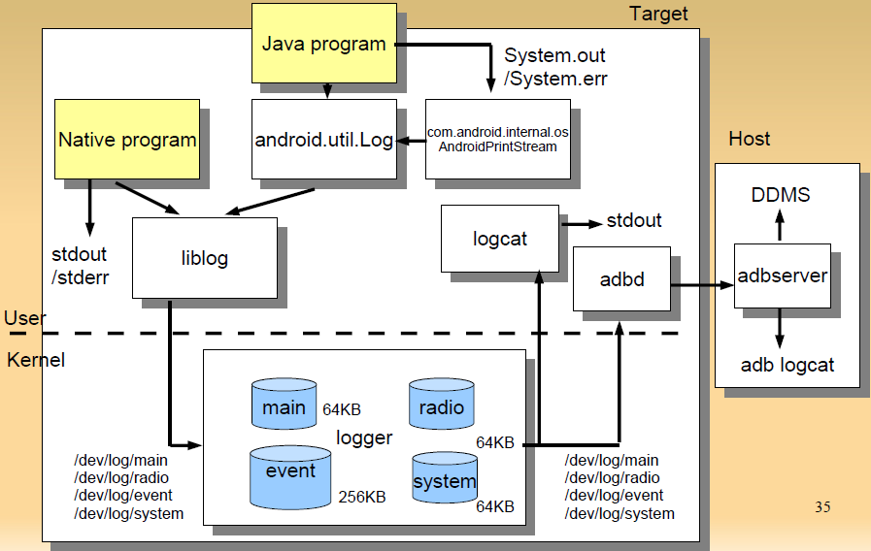
Logger

Slide 14
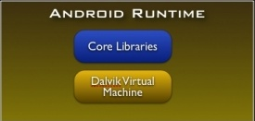
Android S/W Stack - Runtime
Core Libraries
Providing most of the functionality available in the core libraries of the Java language
APIs
Data Structures
Utilities
File Access
Network Access
Graphics
Etc

Slide 15
Android S/W Stack – Dalvik
Dalvik Virtual Machine
Providing environment on which every Android application runs
Each Android application runs in its own process, with its own instance of the Dalvik VM
Compared to JVM:
Android Java = Java SE – AWT/Swing + Android API
16-bit, register-based (vs. 8-bit, stack-based JVM)
Runs .dex files (vs. byte-code in JVM)
More efficient and compact implementation (so that a device can run multiple VMs efficiently）
Different set of Java libraries than Java SDK
Has JIT (Just-In-Time) compilation & concurrent Garbage collection (similar to JVM)

Slide 16
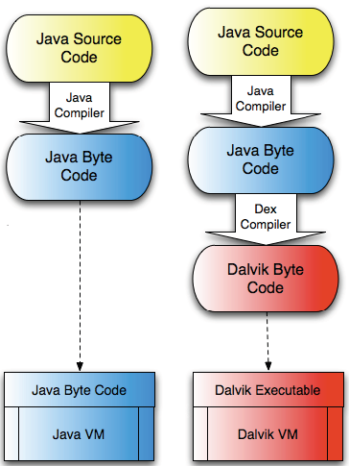
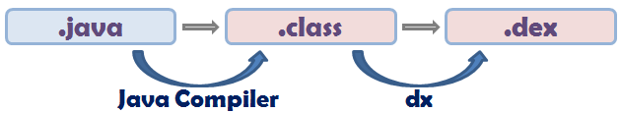
Android S/W Stack – Dalvik
Dalvik Virtual Machine
Executes the Dalvik Executable (.dex) format
.dex format is optimized for minimal memory footprint.
Compilation
Relies on Linux Kernel for:
Threading
Low-level memory management

Slide 17
Example Source code
public class Demo {
public static void foo() {
int a = 1;
int b = 2;
int c = (a + b) * 5;
}
}

Slide 18
Java Byte Code
0: iconst_1
1: istore_0
2: iconst_2
3: istore_1
4: iload_0
5: iload_1
6: iadd
7: iconst_5
8: imul
9: istore_2
10: return
10 bytes
9 reads
10 writes

Slide 19
Android Bytecode
0000: const/4 v0, #int 1 // #1
0001: const/4 v1, #int 2 // #2
0002: add-int/2addr v0, v1
0003: mul-int/lit8 v0, v0, #int 5 // #05
0005: return-void
5 bytes
4 reads
4 writes

Slide 20
File Size Comparison
Contents | Uncompressed jar File |  | Compressed jar File |  | Uncompressed dex File
 | In Bytes | In % | In Bytes | In % | In Bytes | In %
Common System Libraries | 21445320 | 100 | 10662048 | 50 | 10311972 | 48
Web browser Application | 470312 | 100 | 232065 | 49 | 209248 | 44
Alarm check Application | 119200 | 100 | 61658 | 52 | 53020 | 44

Slide 21
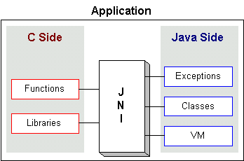
JNI: Java Native Interface
Java interface to non-Java code. It is Java's link to the "outside world"
Native methods are compiled into a dynamic link library (.dll, .so, etc.)
OS loads and links the library into the process that is running the Java Virtual Machine
Part of the Java Developer Kit(JDK), serves as a glue between java side and native side of an application
Allows Java code that runs inside a Java Virtual Machine (JVM) to interoperate with applications and libraries written in other programming languages, such as C, C++, and assembly

Slide 22
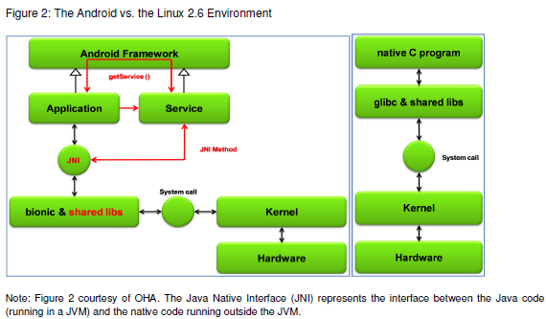
Android vs. Linux

Slide 23
Android Libraries

Slide 24
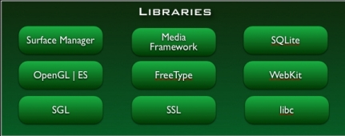
Android S/W Stack - Libraries
Including a set of C/C++ libraries used by components of the Android system
Exposed to developers through the Android application framework

Slide 25
Android S/W Stack – Libraries (Cont)
Features
System C Library (Bionic)
Media Libraries
Surface Manager (Surface Flinger)
Audio Manager (Audio Flinger)
LibWebCore (WebKit)
SGL
3D Libraries
FreeType
SQLite

Slide 26
Android S/W Stack – Libraries (Cont)
Bionic
Custom libc implementation optimized for embedded use
Problem with GNU libc
License | The authors want to keep GPL out of user-space.
Size | Libc will load in each process, so it needs to be small.
Speed | Limited CPU power means it needs to be fast.

Slide 27
Android S/W Stack – Libraries (Cont)
Bionic (Cont)
Properties
BSD license
Small size and fast code paths
Very fast and small custom pthread implementation
No support for certain POSIX features
No compatibility with GNU libc
All native code must be compiled with bionic

Slide 28
Android S/W Stack – Libraries (Cont)
WebKit
An application framework that provides foundation for building a web browser based on open source WebKit browser
Properties
Ability to render pages in full (desktop) view
Full CSS, JavaScript, DOM, AJAX support
Support for single-column and adaptive view rendering

Slide 29
Android S/W Stack – Libraries (Cont)
Media Framework
A media framework based on PacketVideo OpenCore platform
Properties
Support for standard video, audio, still-frame formats
Support for hardware/software codec plug-ins
SQLite
Light-weight relational database management system
Back end for most platform data storgae

Slide 30
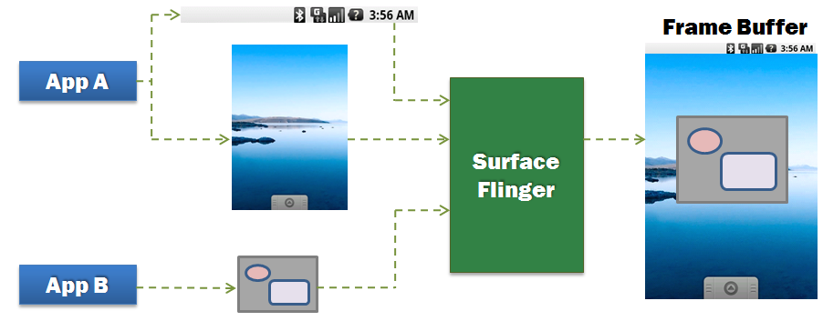
Android S/W Stack – Libraries (Cont)
Surface Manager (Surface Flinger)
Providing system-wide surface composer, handling all surface rendering to frame buffer device
Operation

Slide 31
Android S/W Stack – Libraries (Cont)
Surface Manager (Cont)
Properties
Can combine 2D and 3D surfaces and surfaces from multiple applications
Surfaces passed as buffers via Binder IPC calls
Can use OpenGL ES and 2D hardware accelerator for its compositions
Double-buffering using page-flip

Slide 32
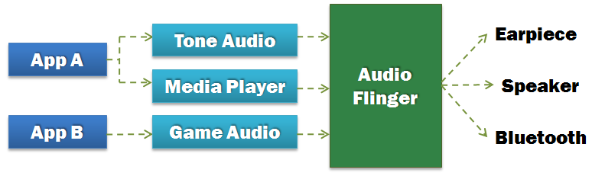
Android S/W Stack – Libraries (Cont)
Audio Manager (Audio Flinger)
Processing multiple audio streams into PCM audio out paths
Operation

Slide 33
Android S/W Stack – Libraries (Cont)
SGL
The underlying 2D graphics engine
3D Libraries
An implementation based on OpenGL ES 1.0 APIs
Using either H/W 3D acceleration (if available) or the included optimized 3D S/W rasterizer
FreeType
Rendering bitmap and vector font

Slide 34
Processes & Threads

Slide 35
Processes and Threads
Processes
When the first of an application's components needs to be run, Android starts a Linux process for it with a single thread of execution (Main Thread).
Android may decide to kill a process to reclaim resources.
Application (.apk)
1
Process
1
Main Thread

Slide 36
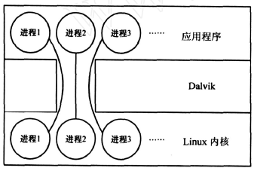
Process Model
One-to-one correspondence between Dalvik applications and Linux kernel processes
Each app runs in its own process
Each process has its own copy of Dalvik VM

Slide 37
Processes and Threads (Cont)
Process (Cont)
We can specify a process where an individual component should run by setting a process name to “process” attribute of <activity>, <service>, <receiver>, or <provider>.
Each component can run in its own process.
Some components share a process while others do not.
Components of different applications also can run in the same process.
We can set a default value that applies to all components by setting a default process to "process” attribute of <application>.

Slide 38
Processes and Threads (Cont)
Threads
Main Thread
All components are instantiated in the main thread of the specified process.
System calls to the components are dispatched from the main thread.
Methods that respond to those calls always run in the main thread of the process.
Components in main thread should not perform long or blocking operations (e.g. network downloads, computation loops)

Slide 39
Processes and Threads (Cont)
Threads (Cont)
Anything that may not be completed quickly should be assigned to a different thread.
Threads are created in code using standard Java Thread objects.
Some convenience classes Android provides for managing threads:
Looper for running a message loop within a thread
Handler for processing messages
HandlerThread for providing a handy way for starting a new thread that has a looper

Slide 40
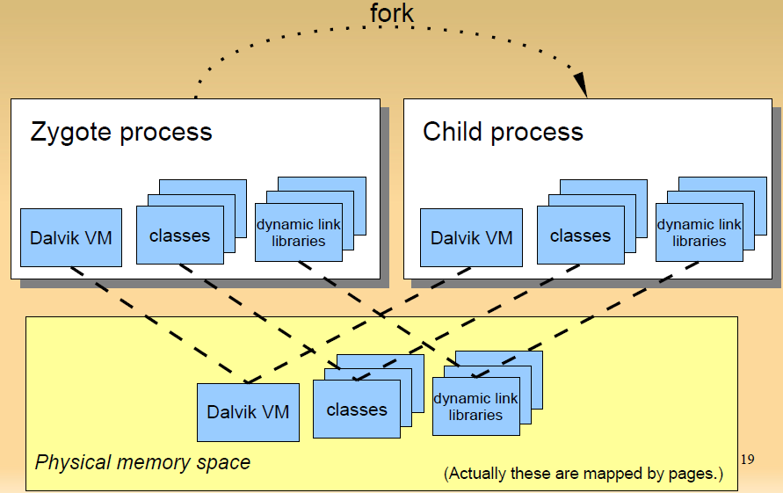
Zygote Process Forks Child Processes

Slide 41
Zygote (Cont)
Zygote process preloads typical (approx. 1800) classes and dynamic link libraries so that child processes start quickly.
Copy-on-write
Only when new process writes page, new page is allocated.
All pages not be written are shared among all zygote children.
Does not use Linux exec() system call

Slide 42
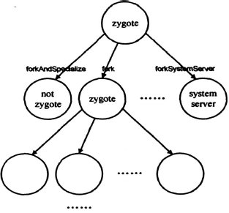
Zygote (Cont)
Only Zygote processes can fork child processes
fork() ,creates a zygote process。
forkAndSpecialize ( ) , creates a non-zygote process。
forkSystemServer ( ) , creates a system server process

Slide 43
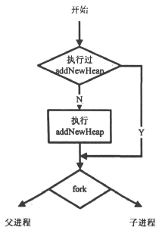
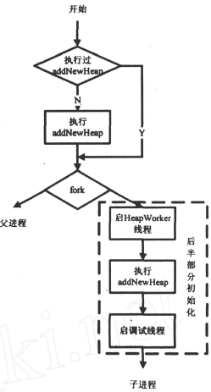
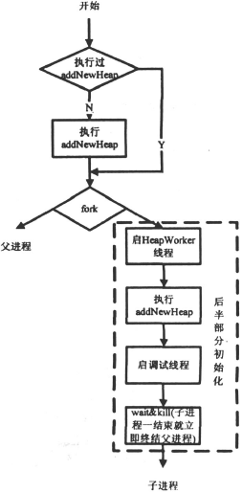
fork()
forkAndSpecialize()
forkSystemServer ( )
Notes:
这三个方法都是本地方法。
先看fork 方法,与另两个本地方法不同的是,fork
方法生成的子进程是一个半初始化的进程,它也是zy2
gote 进程。如果父进程之前已经调用过addNewHeap ,
则不再调用它。这里使用的是写时复制技术,因此zy2
gote 进程是共享同一个堆的。整个初始化到这里就结
束了。
forkAndSpecialize 则不同。首先它创建的子进程
将不再是一个zygote 进程(即离开Zygote 模式,不能
再创建子进程) ,它会启动HeapWorker 线程(一个主要
执行对象的终结函数和引用对象的清理和归队工作的
线程) 和调试线程。其次,它一定会执行addNewHeap
函数,创建一个新的堆,因为一个运行特定任务的进程
不应该和其它进程共享一个堆。
forkSystemServer 和forkAndSpecialize 很相似, 唯
一的不同点是用forkSystemServer 创建的子进程一旦
结束就会立即终止创建它的父进程。
根据Linux 的fork 系统调用可以知道,父子进程
在fork 之后各自堆栈互不相关,但是共享程序正文段
也就是虚拟机核心库代码,dex 文件除外。这样设计
一方面是为了节省内存,另一方面也发挥了Linux 进
程的长处。

Slide 44
UID & GID
UID(user id) and GID(group id) is used for managing multi-user, as in usual Linux system.
Android use this mechanism to isolate applications.
Each application has unique UID.
Can not read/write other application's files.
Zygote runs as UID=0 (root). After forking, each child process’ UID is changed by setuid() system call.

Slide 45
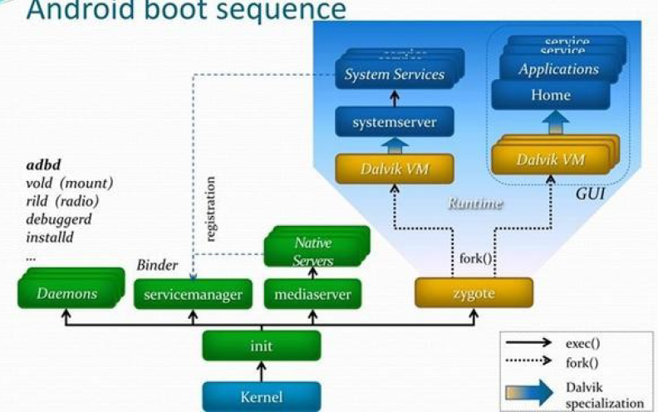
Startup Sequence

Slide 46
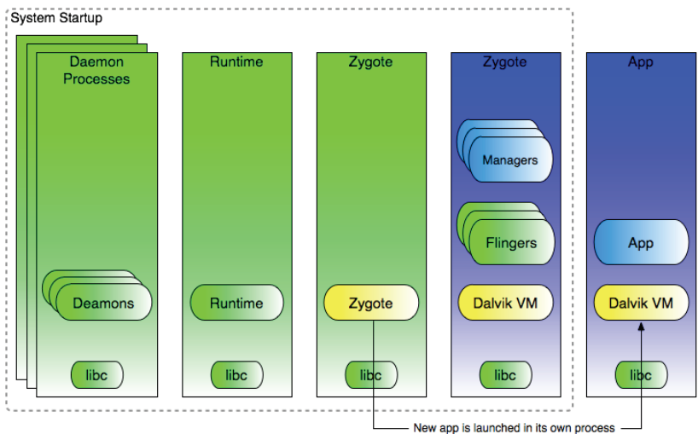
Runtime Processes

Slide 47
Android Power Management

Slide 48
Android Power Management
Problem
Mobile devices depend on battery power and batteries have limited capacity.
Properties of Power Management
PM is built on top of standard Linux Power Management.
PM supports more aggressive power management policy.
Components make requests to keep the power on through “Wake Locks”.
PM supports several different types of wake “Wake Locks”.

Slide 49
Wake Locks
A locked wakelock, depending on its type, prevents the system from entering suspend or other low-power states.
There are two settings for a wakelock:
WAKE_LOCK_SUSPEND: prevents a full system suspend.
WAKE_LOCK_IDLE: prevents low-power states from being entered from idle.
Notes:
, which often cause large interrupt latencies or that disable a set of interrupts, will not be entered
until the wakelocks are released.

Slide 50
Wake Locks (Cont’)
Application holds wakelock on power state
If no wakelocks are held, Android powers down
Ex:
PARTIAL_WAKE_LOCK
CPU on, screen off, keyboard off
SCREEN_DIM_WAKE_LOCK
CPU on, screen dim, keyboard off
SCREEN_BRIGHT_WAKE_LOCK
CPU on, screen bright, keyboard off
FULL_WAKE_LOCK
CPU on, screen on, keyboard bright

Slide 51
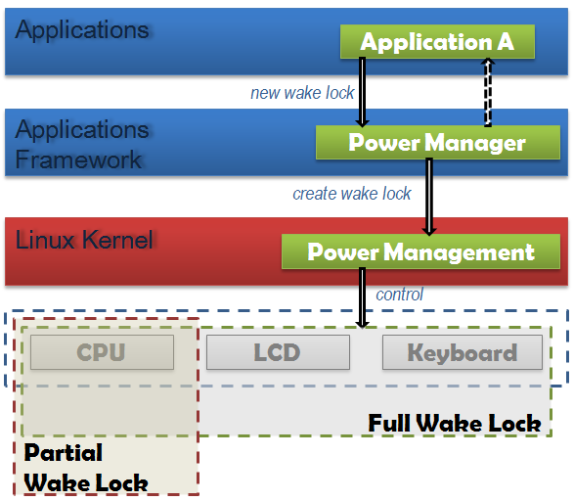
Android Power Management in Action
If there are no active wake locks, CPU will be turned off.
If there are no partial wake locks, screen and keyboard will be turned off.

Slide 52
PM Procedures
All power management calls follow the same basic format:
Acquire handle to the PowerManager service.
Create a wake lock and specify the power management flags for screen, timeout, etc.
Acquire wake lock.
Perform operation (play MP3, open HTML page, etc.).
Release wake lock.

Slide 53
Wakelock Example
PowerManager pm = (PowerManager) GetSystemService (Context.POWER_SERVICE);
PowerManager.WakeLock wl = pm.newWakeLock(PowerManager.SCREEN_DIM_WAKE_LOCK, “tag”);
wl.acquire();
//..screen stays on here
wl.release();
Notes:
PowerManager pm = (PowerManager)mContext.getSystemService( Context.POWER_SERVICE);
PowerManager.WakeLock wl = pm.newWakeLock( PowerManager.SCREEN_DIM_WAKE_LOCK | PowerManager.ON_AFTER_RELEASE, TAG);
wl.acquire();
// ...
wl.release();

Slide 54
Android & Real-Time
A Real-time Extension to the Android Platform
Igor Kalkov et al, JTRES 2012

Slide 55
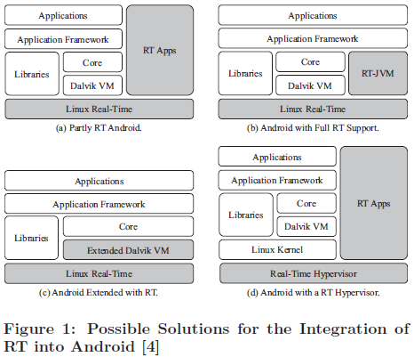
[4] C. Maia, L. Nogueira, and L. M. Pinho. Evaluating Android OS for Embedded Real-Time Systems. In Proceedings of the 6th International Workshop on Operating Systems Platforms for Embedded Real-Time Applications, OSPERT 2010, pages 63–70, Brussels, Belgium, 2010.

Slide 56
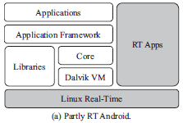
(a) Partly RT Android
Use RT Linux kernel
RT applications are written in C and run on top of RT Linux natively
Non-RT Android applications run on Dalvik VM
Drawback: Android applications cannot be RT

Slide 57
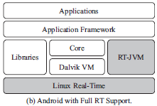
(b) Android with Full RT Support
Use RT Linux kernel
Run RT-JVM alongside Dalvik VM
RT applications are written in Java and run on RT-JVM; non-RT applications run on Dalvik VM
Drawback: Android applications cannot be RT

Slide 58
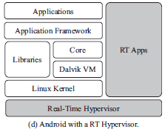
(d) Android on Top of RT-Hypervisor
Use virtualization
RT applications are written in C and run on top of the RT Hypervisor
Android framework is unmodified; non-RT applications run on Android
Typically on multicore processor, and each occupies a separate core.
Drawback: Android applications cannot be RT; not very suitable for single-core systems for performance reasons.

Slide 59
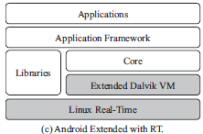
(c) Android extended with RT
Use RT Linux kernel
Extend Dalvik VM to make it RT
Approach adopted in the paper

Slide 60
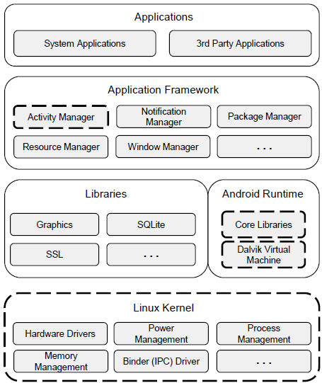
Changed Made to Android
Improved Linux kernel v2.6.29
Patched with PREEMPT_RT
Enabled priority scheduling
Extended Activity Manager
Reliable execution of RT apps
Bypassing OOM process killer ▪
Modified Dalvik VM
Explicit memory management
Notes:
Encapsulated priority selection

Slide 61
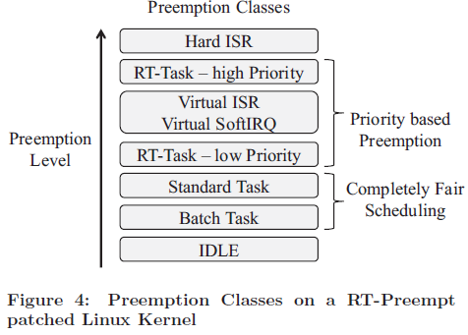
RT-PREEMPT Patch
Hard ISR: HW Interrupt Service Routine
Virtual ISR or Soft IRQ: interrupt handlers converted into preemptible Linux kernel threads

Slide 62
Linux Kernel Modifications
Android 2.2 distribution is based on a modified version of Linux kernel version 2.6.29.
RT-PREEMPT patch is designed for the mainline Linux kernel; needs modification to work with Android’s modified Linux kernel
Authors manually ported RT-PREEMPT patch to work with 2 versions of Android Linux
Goldfish kernel used in Android emulator
Kernel designed for real HW device,

Slide 63
How to Grant Root Privileges?
RT applications require root privileges in order to change the current Linux scheduling class.
But it is unacceptable to allow unrestricted access to the su command, which grants the user root privileges on Linux.
Authors adapted an open-source access control software called superuser, for controlling privileged access
Intercept all internal calls to the su command by replacing its binary in the system directory.
Every request for root privileges from a running application is redirected to the device user as a GUI dialog asking for permission.

Slide 64
How to Set RT Sched Class & Priorities?
Linux scheduler uses priorities within the range [0..99] for handling real-time tasks and the range [100..139] for all other tasks. (Smaller value denotes higher priority)
System call sched_setscheduler() can be used to set scheduling class and priority
But it is implemented in a native C library, hence not directly accessible to Android apps
Android system toolbox contains a tool called renice, which allows Android apps to call sched_setscheduler()

Slide 65
Low Memory Killer
Android assigns every running process p_{i} a specific Out Of Memory (OOM) Adjustment Value oom_adj(p_{i}). More important processes have lower values of oom_adj.
Android defines memory threshold values m_thr_{l}, with six different levels of available system resources. For every moment in time, the set of killable applications depends on the amount of the currently available memory m_{free} as (l∈ [0, ..., 5])
For example, values mem_thr₃ = 5120 pages and adj_thr₃ = 7 will cause low memory killer to start terminating processes with oom_adj > 7 as soon as the amount of free memory gets lower than 20 MB (5120 pages with 4KB each=20 MB).
RT processes must get lowest possible 𝑎𝑑𝑗_{𝑝} values
Notes:
Internal process importance
Depends on the application class (background / foreground)
Reflected in OOM (Out-of-Memory) adjustment values 𝑎𝑑𝑗𝑝
Built-in OOM process killer
Killing “unimportant” processes first
Memory thresholds 𝑚𝑒𝑚_{𝑡} and corresponding levels 𝑎𝑑𝑗_{𝑡}
Example with 𝑚𝑒𝑚₃ = 20 𝑀𝐵 and 𝑎𝑑𝑗₃ = 7
Terminate processes with 𝑎𝑑𝑗_{𝑝}≥ 7 on 𝑚𝑒𝑚_{𝑓𝑟𝑒𝑒} ≤ 20 𝑀𝐵
RT processes must get lowest possible 𝑎𝑑𝑗_{𝑝} values
Each RT process has a boolean flag isRealtime set to 1, indicating that its oom_adj should be the lowest possible value

Slide 66
Memory Management Issues
Advantages:
Smart low memory process killer
Process-independent GC (Dalvik VM)
Disadvantages:
Mark-and-sweep algorithm
Execution of all threads is suspended (up to 200 ms) during GC
No reliable prediction of process behavior
Explicit allocation control

Slide 67
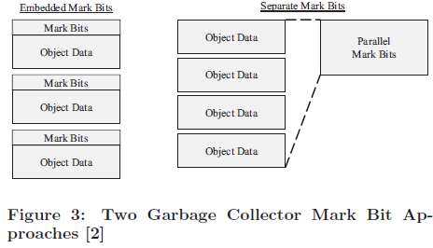
Mark & Sweep GC
The DVM garbage collector uses mark and sweep algorithm, which works in two phases.
In the mark phase, every referenced object is marked as being in use by setting the corresponding Mark Bits
In the sweep phase, GC frees all unmarked objects.
Two different approaches to marking objects in memory for garbage collection: embedded or separate mark bits.
Android uses separate mark bits

Slide 68
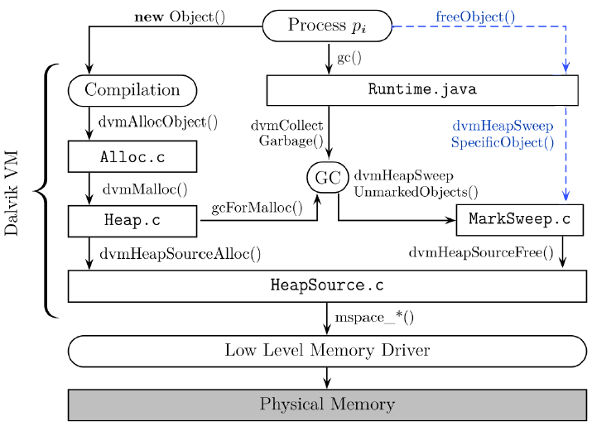
Explicit Memory Management
Instead of relying on automatic Mark & Sweep GC, add APIs (blue text in figure) to enable developers to explicitly free memory when necessary.

Slide 69
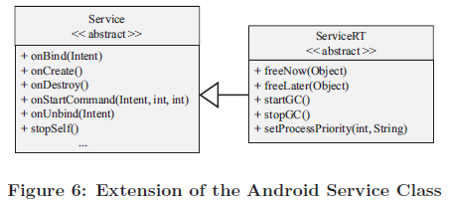
New ServiceRT Class
Introduce new class ServiceRT.java as user-friendly encapsulation of RT-related APIs
Extends Android’s native Service.java class
API for priority selection for own process
API for explicit memory deallocation

Slide 70
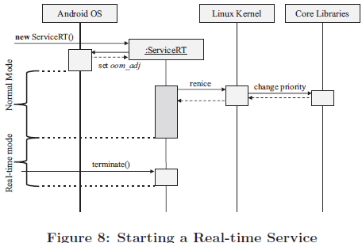
Using ServiceRT Class
After spawning a new Linux process, Android instantiates a new ServiceRT object, registers it in the system and resets the oom_adj value according to the object’s properties.
After initialization finishes, the service is executed with standard application priority, like a non-real-time service.
The service internally calls setProcessPriority(), which calls renice to acquire real-time priority. The corresponding service is then running with real-time priority.
From this moment on, it can be used for execution of time-critical tasks.
Notes:
As described
above, this method encapsulates invocation of the
renice tool, which changes the priority value and scheduling
class for the underlying Linux process.

Slide 71
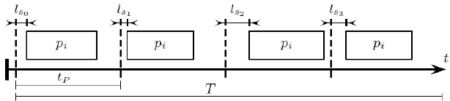
Evaluation
Testing device: HTC Dream phone with 528 MHz MSM7201A ARM11 processor and 192 MB of RAM.
Test 1: Periodic execution
Compare scheduled & actual execution time
Period 𝑡_{𝑃} = 1 𝑚𝑠 to 𝑡_{𝑃} = 1 𝑠
Running time 𝑇 = 20 𝑠 to 𝑇 = 1 ℎ
Different process priorities
Idle system or high CPU load
Notes:
Background service based on ServiceRT class

Slide 72
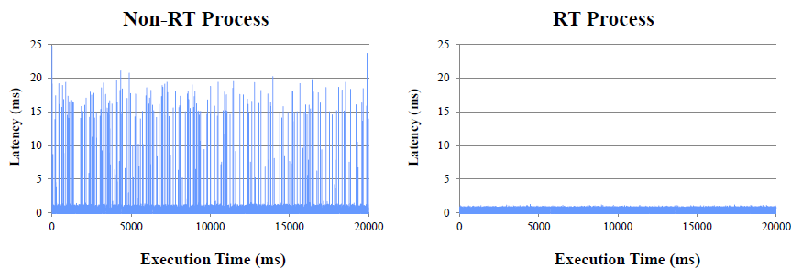
Latency Evaluation (1)
System state: idle
𝑡_{𝑃} = 5 𝑚𝑠
𝑇 = 20 𝑠
Priorities: 120 (default) vs. 40 (real-time)

Slide 73
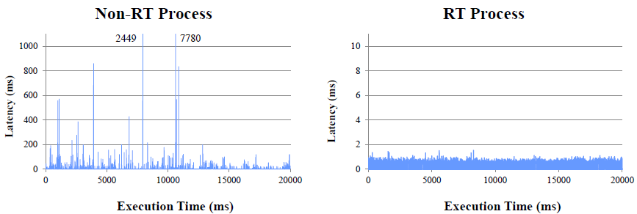
Latency Evaluation (2)
System state: under load
𝑡_{𝑃} = 5 𝑚𝑠
𝑇 = 20 𝑠
Priorities: 120 (default) vs. 40 (real-time)

Slide 74
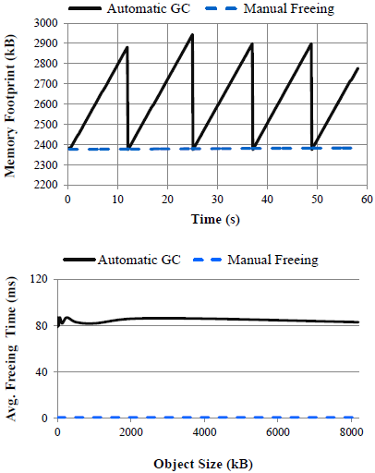
Memory Management Evaluation
Test 2: Continuous data receiving
Over a 54 Mbit Wi-Fi connection
Count: 2000 packets
Size: ~ 1 kB each
Can be released after processing
Test 3: Explicit object deallocation
Allocate an object of a given size
Free it immediately
Measure the elapsed time
Calculate average of 10 cycles
For different sizes: 1 Byte to 8 MB

Slide 75
Conclusions
New approach
Patched Linux kernel & Android components
Handling of OOM adjustment values
Use Linux real-time priorities for Android applications
Explicit memory management
Evaluation
Avoiding undesired invocations of the GC
Scheduling latency < 2 ms for real-time processes

